Slide 1
Joint Integrated protection system (JIPS): Systems engineering Plan (SEP) Update Internal program review (Ipr) 2
Team 1:
Chris Aall, Ryan Altenbaugh, Kimberly Battle, Steve Mazza, Liz Swisher, Maranatha Zopfi
5 Sept 2012

Slide 2
IPR 2 Agenda:
Program Summary: Review
Design Methods for External/Internal Interfaces
Test and Evaluation Strategies to Reduce Technical Risk
Design of Production and Support Systems
Low-Rate Initial Production (LRIP) Description
Production Levels vs. Deployment Schedule
Support Infrastructure vs. Deployment Schedule
Management of Obsolescence Issues
Training and Personnel Assignments to Support Manpower Requirements
Conclusion/Additional Concerns
2

Slide 3
Program Summary: Required Capabilities
The Joint Integrated Protection System (JIPS) shall protect permanent and semi-permanent bases in Southwest Asia from conventional and asymmetric ground attack.
The system shall integrate the Stronghold* sensor suite and C2 station, and a set of SWORDS* Unmanned Ground Vehicles (UGVs). (* Systems described in following slides)
The system shall be in full compliance with the connectivity and interoperability requirements of the Global Information Grid (GIG).
The system shall include all necessary support and maintenance documentation/procedures.
The system shall be ready for deployment in Southwest Asia by the end of 2018.
3
Notes:
As a review of IPR 1, the goal of the JIPS program is to protect permanent and semi-permanent bases in Southwest Asia from conventional and asymmetric ground attack.
Some additional top level required capabilities of the JIPS program are as follows: (see above)
This list does not contain ALL of the required capabilities, but summarizes those capabilities considered the most important and emphasized by program leaders and the end user community.

Slide 4
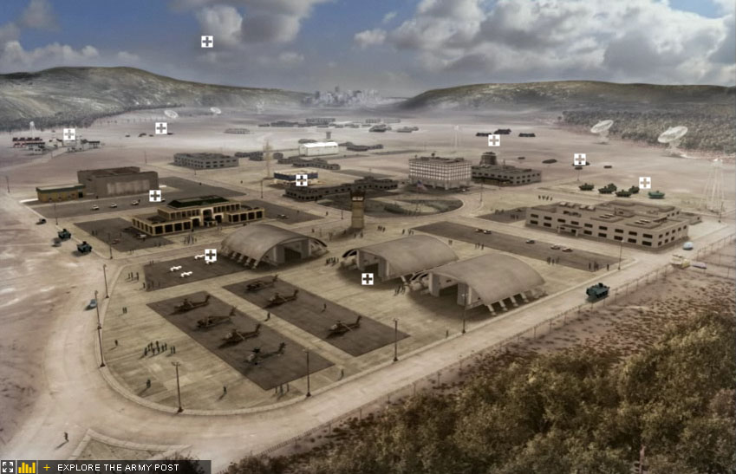


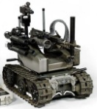






Program Summary Review: Operational Concept description
JIPS OV-1
GIG
SWORDS UGV
SWORDS UGV
C2 Station
SWORDS UGV
ENGAGE
Stronghold Sensor Suite
4
Notes:
This OV-1 for JIPS shows a notional use case scenario. The JIPs shall protect permanent and semi-permanent bases in Southwest Asia from conventional and asymmetric ground attack. The C2 station will communicate with the Stronghold Sensor Suite to detect possible threats or attacks around the perimeter of the base. The command will determine if the threat is real and needs to be addressed based on all available information (including intel from the GIG). The SWORDS (or MAARS) UGV system will then be remotely controlled to engage and neutralize the threat. Through the use of integrating stationary sensors and UGVs, the command will have exceptional situational awareness and ability to respond to threats.

Slide 5
Design Methods for External/Internal Interfaces
Utilization of DoD standard or commercial network interfaces where available
Consistency of communications protocols across UGV’s, sensors, and control system
Hide unnecessary technical details from the end user
Design for portability, interoperability, and interchangeability
Develop simulation tools to assist in debugging external/internal interfaces
Customizable user interface to accurately graphically represent FOBs at installed location
Form Interface Control Working Group (ICWG) as early in the design phase
5
Notes:
Identify standards early, consistency across family of applications. The ICWG is in charge of Interface Control Documents (ICD) for hardware, Interface Design Documents (IDD) for software, and recommending changes to the Configuration Control Board.

Slide 6
Test and Evaluation Strategies to Reduce Technical Risk
5
4 |  | 2,3 |  | 4
3
2 |  |  |  |  | 1
1
 | 1 | 2 | 3 | 4 | 5
Risks
1: Schedule (Medium)
2: Integration (Medium)
3: Funding (Medium)
4: Joint Communications (High)
Impact
Integration and Joint Communications both have associated technical risk!!
Probability
High Risk
Medium Risk
Low Risk
6
Notes:
Based on the risk assessment discussed during IPR 1, 4 risk areas were identified in relation to the JIPS program. Integration and Joint Communications are the two areas considered to have the most technical risk requiring test and evaluation as part of their risk mitigation strategy.
Because these are COTS systems developed by different contractors in different countries, there may be some integration issues. To mitigate this risk, there needs to be tight coordination and multiple reviews to ensure that interfaces and information flow prior to testing. Data should also be collected from previous tests and demonstrations performed by ARL, TARDEC, and DARPA.
Facilitating joint communications was assessed as having high risk due to technical complexity associated with data interchange between two unique systems. Joint communications risk will be mitigated by utilizing compatible sensor suites and designing universal interface mechanisms.

Slide 7
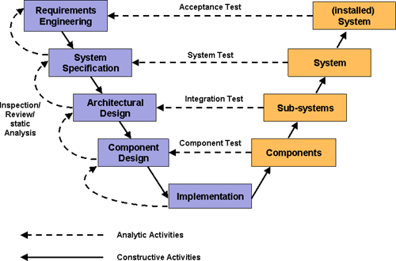
Test and Evaluation Strategies to Reduce Technical Risk
Multiple layers of testing will be performed to reduce risk and ensure successful system development.
Notes:
Test and Evaluation will also be used to reduce technical risk of the integration and joint communications of Stronghold and SWORDS. Testing will occur throughout the lifetime of the JIPS program and will include the expertise and input from critical stakeholders such as acquisition and development partners.
Prior to test and evaluation activities, modeling and simulation will be used to predict the likelihood of successful integration and to identify potential system interoperability issues.
Component level testing will be performed as necessary to verify the feasibility and proper operation of required sub-systems/components. In some cases, laboratory testing will be utilized as an initial test environment before testing in the field.
As system components mature, full-scale integrated system testing will be performed against the established metrics. Additionally, a sample of end-users will be used to verify usability, human factors integration (HMI), and training requirements. Feedback from end-users will be incorporated into the system design.

Slide 8
Design of Production and Support Systems
Production Systems
Producibility
Process
Manufacturing Instructions
Design Stability
Materials
Facilities
Tools
Personnel
Training
Green Engineering
Supply Chain Management
Total Quality Management
Producibility Engineering and Planning (PEP)
Production Readiness Review (PRR)
8
Notes:
Producibility is “ the measure of the relative ease and economy of producing an item.” We designed and integrated the system with Producibility in mind, and because of this, we were able to define an effective manufacturing process as well as develop clear manufacturing instructions. The design is stable, and we have identified the raw materials, finished goods, and processing materials that will be consumed during the manufacturing process, such as lubricants and solder. Currently available facilities, standard tools, and existing personnel can be used for fabrication, assembly, manufacturing, and test operations and have demonstrated industrial base viability. In the event that new staff needs to be hired, there will be classroom instruction and on-the-job training. Green Engineering will be utilized to reduce the environmental impact of products and production operations, and as a result, there will be an increase in profitability through savings in manufacturing costs by implementing waste elimination strategies.
Supply Chain Management is being utilized to efficiently integrate suppliers, manufactures, warehouses, and stores, so that everything is produced and distributed at the right quantities, to the right location, and at the right time, in order to minimize system wide cost while satisfying service level requirements.
Total Quality Management is our strategy to continuously improve processes and performance at every level, and in all areas of responsibility.
We had already implemented Producibility Engineering and Planning (PEP) as part of our Systems Engineering approach. This will ensure that our system can be produced in the required quantities and in the specified time frame, efficiently and economically, and will meet necessary performance objectives within its design and specification constraints. We have also conducted a PRR to ensure that the design is ready for production.

Slide 9
Design of Production and Support Systems (cont.)
Support Systems
Personnel – Operators and Maintainers
Training
Technical Manuals
Tools
Maintenance Concept
Facilities
Configuration Management
Life-Cycle Sustainment Plan (LCSP)
9
Notes:
We have conducted training classes for our operators and maintainers. A web-based training was developed. The final Technical Manuals have been verified. The Repair Parts and Special Tools List (RPSTL) is included in the Maintenance TM, and no special tools are required.
The maintenance concept supports the Army two level concept: if the system cannot be repaired in the field, the effected Line Replaceable Unit (LRU) will be removed and replaced at the field level to restore the system to an operational ready condition. The LRU will then be sent to a repair facility to be repaired. A maintenance allocation chart (MAC) was developed and can be found in the Maintenance TM.
We have already implemented a sound Configuration Management process. CM will ensure that after the baselines are initially established, all changes properly controlled.
At this point the LCSP describes the content and implementation status of the Product Support Package to achieve the Sustainment KPPs/KSAs.

Slide 10
Low-Rate Initial Production (LRIP) Description
According to Defense Acquisition University:
Intended to result in completion of manufacturing development in order to ensure adequate and efficient manufacturing capability
Determine the Quantities necessary to provide production or production representative articles
The DOT&E, following consultation with the PM, determines the number of production or production-representative test articles required for LFTE and IOTE
Minimum the quantity needed for LFTE and IOTE to include spares
Maximum 10% of the full rate quantity determined by MDA
Establish an initial production base for the system; and permit an orderly increase in the production rate for the system, sufficient to lead to full-rate production upon successful completion of operational (and live-fire, where applicable) testing.
10

Slide 11
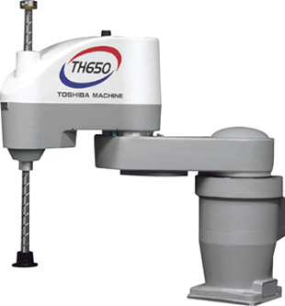
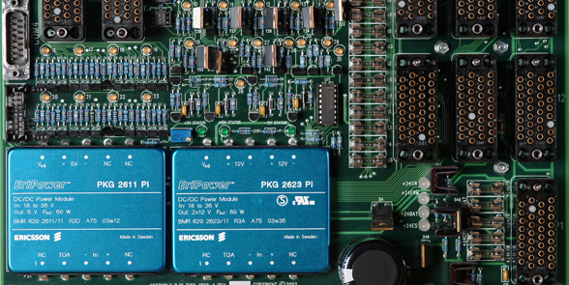
Production Levels vs. Deployment Schedule
Full rate initial production will include manufacturing improvements for producibility, and manufacturing speed in order to fulfill the deployment schedule:
- Automatic inserters for circuit board population
- Pre-oriented electrical components in tubes
- Reduction in laborer component handling
- Aim to produce a modular platform
11
Notes:
Full rate initial production will include manufacturing improvements for producibility, and manufacturing speed in order to fulfill deployment schedule:
Employ automatic inserters such as SCARA robots for circuit board population. This will significantly increase production rates of circuit boards necessary for SWORDS robot communication with Command and Control.
To complement automatic insertion, the circuit components will be pre-oriented in tubes, and then directly fed to the robotic placement assembly
Reduction in laborer component handling in order to reduce circuit contamination, reduce labor hours, and maintain consistent quality
We also aim to produce a modular platform so that in case of defect discovery the replacement will be available in the form of a pre-assembled module
It is the intent, through implementation of these improvements that the system will be available in the quantities requested for deployment.
Additionally, transportation, installation and support of the systems will be in place prior to the first deployment.

Slide 12
Support Infrastructure vs. Deployment Schedule
Support Organizations:
SPAWAR Robotics Reserve Mission available to support during JIPS deployment
SSC San Diego Unmanned Systems Reserve Unit
Transportation:
Contractor prepared shipping containers on military aircraft.
Installation:
TRADOC will be leveraged to develop doctrine for deployment, operation and maintenance activities
Retirement:
System components are designed to be reset or demanufactured and recycled.
12
Notes:
Support Organizations:
The SPAWAR RRM provides operational, technical and programmatic assistance to its customers as well as training to civilian DoD, “First-Responder”, and Law enforcement personnel that operate unmanned robotic systems.
The Unmanned Systems Reserve Unit is a SSC San Diego staffed program, providing formal operator training for the user. This reserve unit intends to define the role of small robots in first response situations, and actively participates in organizations and conferences that specifically address robotic-assisted crisis response.
Transportation:
The transportation of the Joint Integrated Protection System will be facilitated by National Guard personnel. The equipment will be packaged in contractor prepared shipping containers and be transported on C-130 Hercules cargo planes from Stratton Air National Guard Base, NY to the respective theater of operations.
Installation:
TRADOC will be leveraged to develop doctrine for deployment, operation and maintenance activities surrounding the Joint Integrated Protection System.
Retirement:
System components are designed to be reset or demanufactured and recycled. Sierra and Letterkenny Army Depots will aid in the reset of turned in robotic and communications system.

Slide 13
Management of Obsolescence Issues
The system designer must consider the expected life of each component of the system relative to the life of the system.
If component life is less than system life then there should be a plan for component replacement.
The system plan should address obsolescence in design vs. leaving it to chance.
The length of the acquisition schedule plays a role in obsolescence particularly when choosing rapidly moving technology.
13

Slide 14
Training and Personnel Assignments to Support Manpower Requirements
Manpower requirements span both operation and maintenance and staffing quantity for both must be sufficient
Assignments align personnel to appropriate human factors in the system, both physical and psychological
Skill levels are determined for all human activities and form the basis for individual position requirements.
Resources are evaluated comparing current skill level against that needed. The difference forms the basis for training.
14
Notes:
“Operator personnel requirements are derived through the human factors analysis, particularly through the generation of the detailed operator task analysis and operational sequence diagrams. Maintenance personnel requirements evolve from the maintainability analysis, the supportability analysis and the detail maintenance task analysis.” (B&F, pg. 492)

Slide 15
Conclusion/Additional Concerns
System Design is ready for LRIP
Support systems are in place ready for fielding
Identification of Spare Quantities for IOTE
Complete Industrial Capabilities Assessment for long term production
Characterize the available technology and Manufacturing process
Leverage off the Advanced Robotic Vehicle Manufacturing Program
Create an Obsolescence Risk Reduction Program
15
Notes:
Advanced Manufacturing Program (Congressional Report)- to develop business methods that will allow limited quantity production run items to be made ina cost effective manner. Scope of this effort is to develop an e-commerce solution that works in conjunction with rapid prototyping techniques, a solution that provides a seamless transition from R&D to manufacturing.

